Slide 1

Data Warehousing
&
Data Mining(CSC496)
By
Mr. Usman Shehzaib
(Assistant Professor)
Department of Computer Science
CUI Lahore Campus

Slide 2
Extract, Transform, Load (ETL)
Extract only relevant data from the internal source systems or external systems, instead of dumping all data (“data junkhouse”)
The ETL completion can take up to 50-70% of your total effort while developing a data warehouse.
These ETL efforts depends on various factors which will be elaborated as we proceed in our lectures regarding ETL.
Notes:
In the context of extract, transform, and load (ETL) functions, please note that we need to extract only relevant data from the internal source systems or external systems. We donot just merely dump all data from these sources in our data warehouse. In fact, we want to develop a data warehouse that can meet the needs of our users (business analysts, decision makers). By just blindly making a data warehouse without understanding the requirements of your users will just increase the complexity and will result in the wastage of time. Therefore; understand your users’ requirements.
The whole ETL functions can take up to 50-70% of your total effort while developing a data warehouse. The reason is that for extraction you might be extracting large data from disparate sources. Each source might give you challenges in understanding the nature of source system and its data and associated metadata. You might use third party tools or write your on scripts/code to extract data. You also need to devise strategies to capture change in source data systems. All these activities take much of your project’s time.
In addition to the data extraction, the data transformation is again a time consuming task. The activities may include change in format of data, restructuring of data, filling missing data, preparing aggregates and much more. The basic intension is to integrate/consolidate, standardize and transform the data in a form that can be used in data warehouse to provide strategic information.
Similar to extract and transform functions, the load function can also take much of your time in loading and testing bulk of data (millions of rows) in your data warehouse. As mentioned in your book, it might take 1-2 week to initial physical loading of data.
We will discuss further details of these functions in the upcoming slides and lectures.
Please move to the next slide

Slide 3
Architecture of DW
Information Sources
Data Warehouse
Server
(Tier 1)
OLAP Servers
(Tier 2)
Clients
(Tier 3)
e.g., MOLAP
Analysis
Semistructured
Sources
Data
Warehouse
serve
extract
transform
load
refresh
Query/Reporting
serve
e.g., ROLAP
Operational
DB’s
serve
Data Mining
Staging area
Data Marts
Notes:
In this slide, you can view main functional areas that are typically inloved in the techincal architecture of a data warehouse. Our today’s lecture starts discussion regarding the ”extract, transform, load, and refresh” functions of ”Data Staging Area”. This area is highlighted with red circle. We call it ”staging area” because, here, we temporary store and prepare data in a form that can be stored in a data warehouse. In fact, the extracted data from disparate sources needs to be changed, converted, and made ready in a format that is suitable for querying and analysis or simply we can say that we are preparing data for our dimenional model. Here, three important functions need to be performed, i.e., extract, transform, and load. The details of these functions have been discussed in the forthcoming slides and lectures. Please move to the next slide.

Slide 4
Purpose of ETL
ETL functions reshape the relevant data from the source systems into useful information to be stored in the data warehouse. Without these functions, there would be no strategic information in the data warehouse. If the source data is not extracted correctly, cleansed, and integrated in the proper formats, query processing, the backbone of the data warehouse, could not happen.

Slide 5
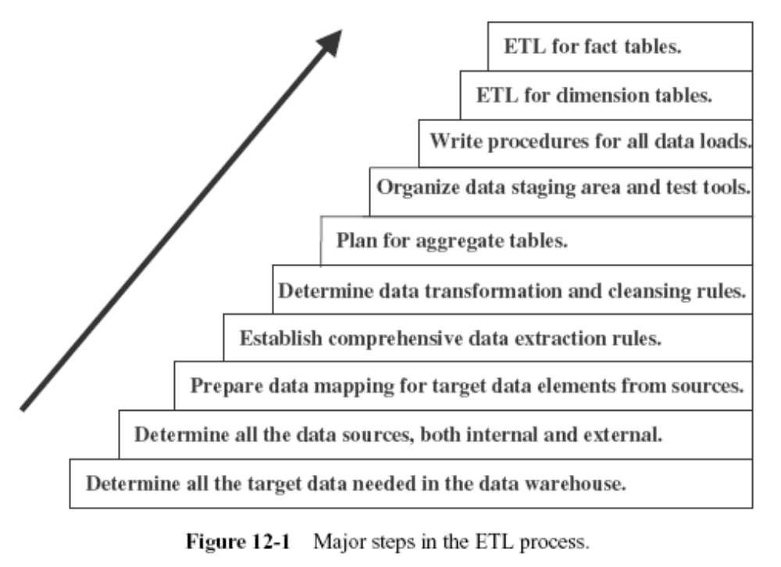

Slide 6
Types of activities and tasks that compose the ETLprocess
Split one source data structure into several structures to go into several rows of the target database.
Read data from data dictionaries and catalogs of source systems.
Read data from a variety of file structures including flat files, indexed files, and legacy system databases.
Load details for populating atomic fact tables.
Aggregate for populating aggregate or summary fact tables.
Transform data from one format in the source platform to another format in the target platform.
Derive target values for input fields (example: age from date of birth).
Change cryptic values to values meaningful to the users (example: 1 and 2 to male and female).

Slide 7
DATA EXTRACTION

Slide 8
DATA EXTRACTION
For operational systems upgrade, all you need is one-time extractions and data conversions.
For a data warehouse, you have to extract (increased complexity, 3rd party tools):
  data from many disparate sources.
  data on the changes for ongoing incremental loads as well as for a one-time initial full load.

Slide 9
list of data extraction issues
Source Identification—identify source applications and source structures.
Method of extraction—for each data source, define whether the extraction process is manual or tool-based.
Extraction frequency—for each data source, establish how frequently the data extraction must by done—daily, weekly, quarterly, and so on.
Time window—for each data source, denote the time window for the extraction process.
Job sequencing—determine whether the beginning of one job in an extraction job stream has to wait until the previous job has finished successfully.
Exception handling—determine how to handle input records that cannot be extracted

Slide 10
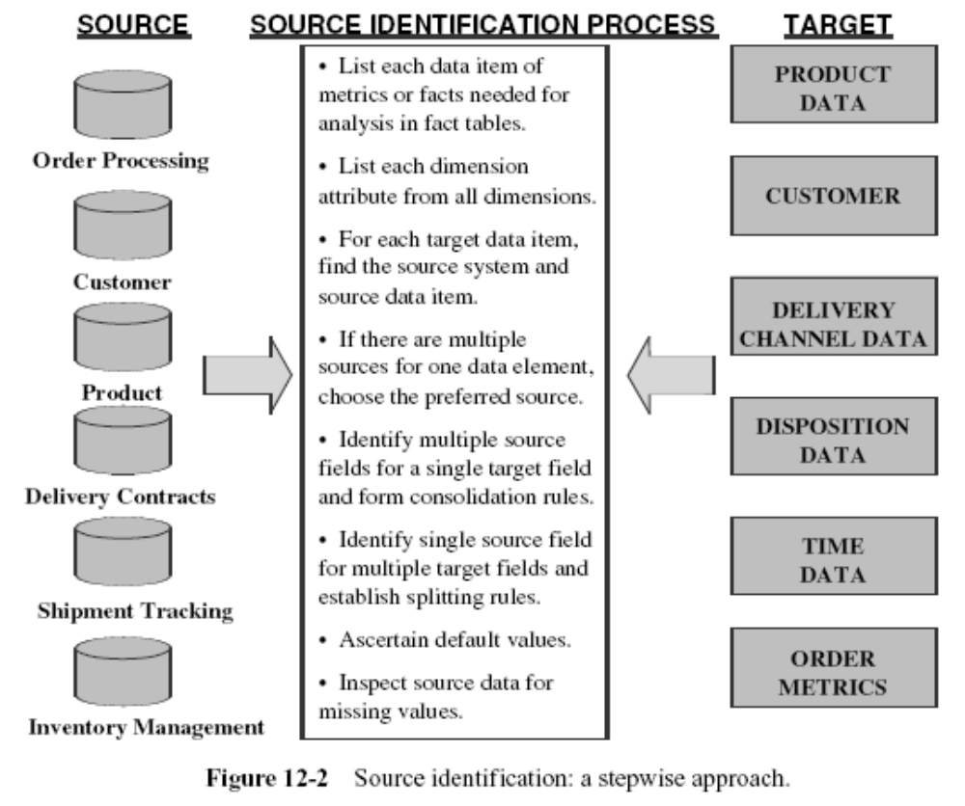

Slide 11
Data in Operational Systems.
Two cathegories:
Current Value. (most of the attributes) The value of an attribute remains constant only until a business transaction changes it. Data extraction for preserving the history of the changes in the data warehouse gets quite involved for this category of data.
Periodic Status. (not as common as the previous category) The history of the changes is preserved in the source systems themselves. Therefore, data extraction is relatively easier.

Slide 12
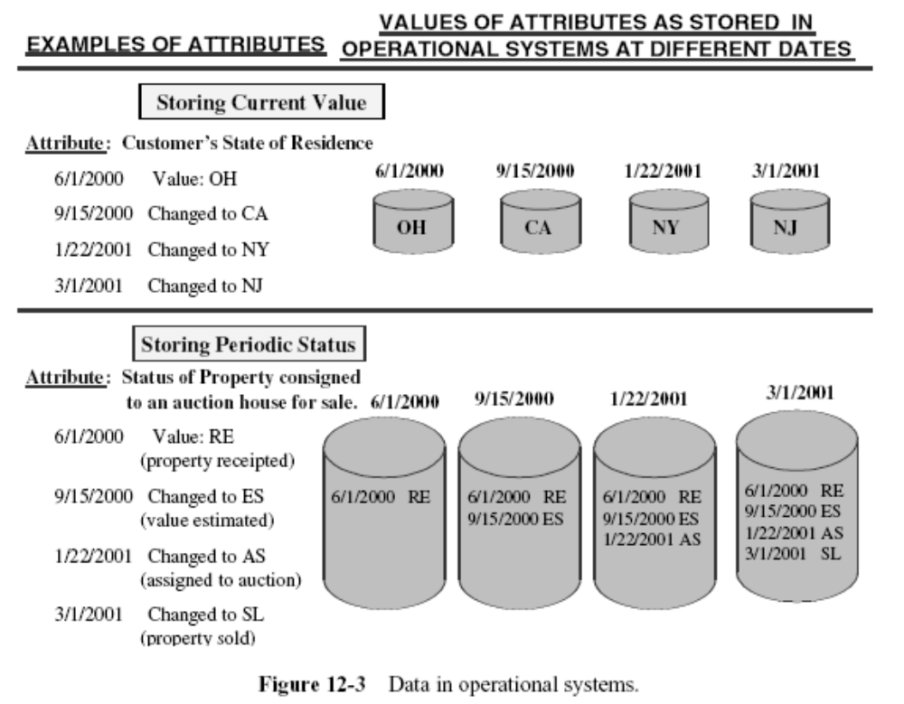

Slide 13
Data in Operational Systems.
When you deploy your data warehouse, the initial data as of a certain time must be moved to the data warehouse to get it started. This is the initial load.
After the initial load, your data warehouse must be kept updated so the history of the changes and statuses are reflected in the data warehouse. There are two major types of data extractions from the source operational systems:
  “as is” (static) data
  data of revisions.

Slide 14
Data in Operational Systems.
“As is” or static data is the capture of data at a given point in time. It is like taking a snapshot of the relevant source data at a certain point in time.
Data of revisions is also known as incremental data capture. Incremental data capture may be immediate or deferred. Within the group of immediate data capture there are three distinct options.

Slide 15
Options for data capture
Immediate Data Extraction.
  Capture through Transaction Logs.
  Capture through Database Triggers.
  Capture in Source Applications.
Deferred Data Extraction.
  Capture Based on Date and Time Stamp.
  Capture by Comparing Files.

Slide 16
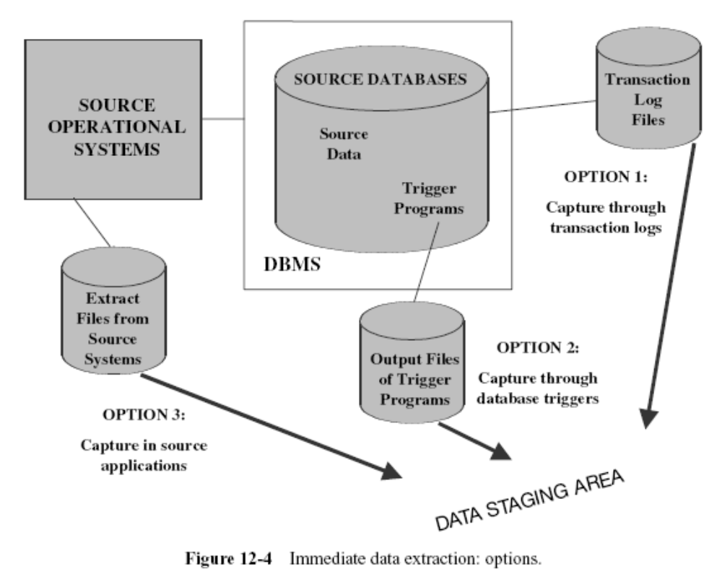

Slide 17
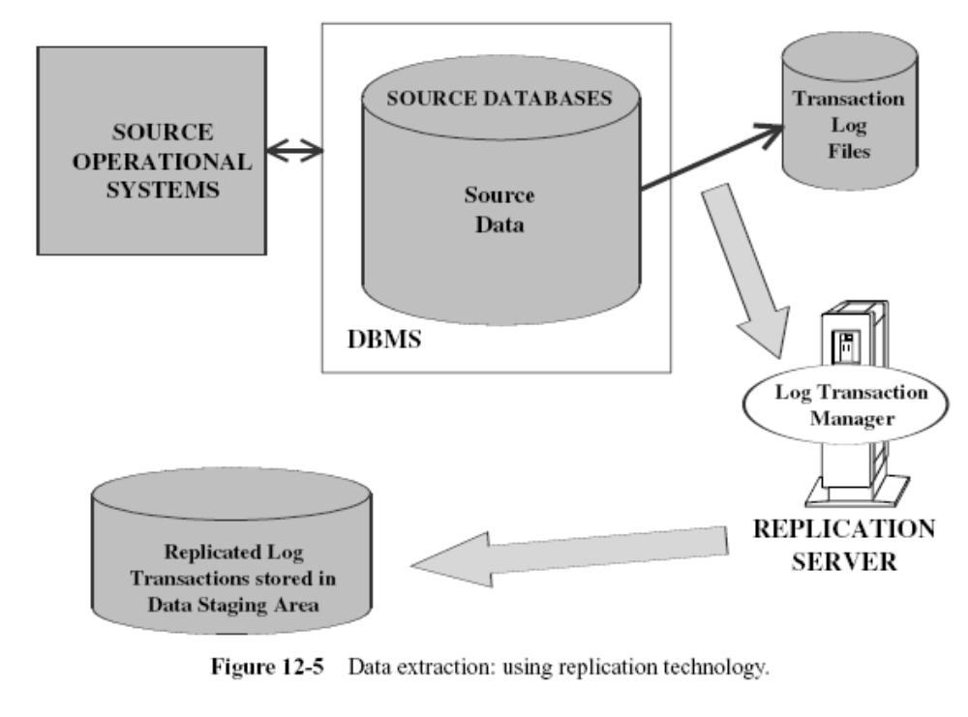

Slide 18
Data capture through database triggers
Data capture through database triggers occurs right at the source and is therefore quite reliable.
You can capture both before and after images.
Building and maintaining trigger programs puts an additional burden on the development effort.
Execution of trigger procedures during transaction processing of the source systems puts additional overhead on the source systems.
This option is applicable only for source data in databases.

Slide 19
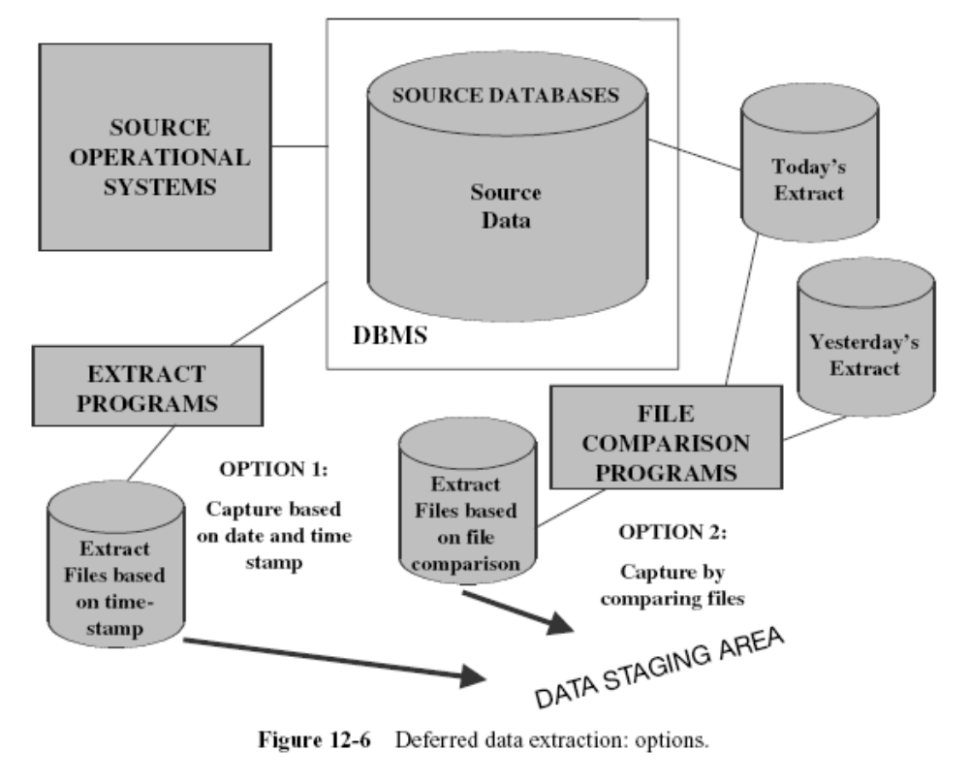

Slide 20
Capture Based on Date and Time Stamp
Deletion of source records presents a special problem. If a source record gets deleted in between two extract runs, the information about the delete is not detected.
You can get around this by marking the source record for delete first, do the extraction run, and then go ahead and physically delete the record.
This means you have to add more logic to the source applications.

Slide 21
Capture by Comparing Files
If none of the above techniques are feasible for specific source files in your environment, then consider this technique as the last resort.
This technique is also called the snapshot differential technique because it compares two snapshots of the source data.

Slide 22
Data Warehousing
&
Data Mining(CSC496)
By
Mr. Usman Shehzaib
(Assistant Professor)
Department of Computer Science
CUI Lahore Campus

Slide 23
ETL
DATA TRANSFORMATION

Slide 24
DATA TRANSFORMATION
Extracted data is raw data and it cannot be applied to the data warehouse
All the extracted data must be made usable in the data warehouse.

Slide 25
Quality of data
Major effort within data transformation is the improvement of data quality.
This includes filling in the missing values for attributes in the extracted data.
Data quality is of paramount importance in the data warehouse because the effect of strategic decisions based on incorrect information can be devastating.

Slide 26
Basic tasks in data transformation
Selection - beginning of the whole process of data transformation. Select either whole records or parts of several records from the source systems.
Splitting/joining - types of data manipulation needed to be performed on the selected parts of source records. Sometimes (uncommonly), you will be splitting the selected parts even further during data transformation. Joining of parts selected from many source systems is more widespread in the data warehouse environment.
Conversion - all-inclusive task. It includes a large variety of rudimentary conversions of single fields for two primary reasons—one to standardize among the data extractions from disparate source systems, and the other to make the fields usable and understandable to the users.

Slide 27
Basic tasks in data transformation(2)
Summarization. Sometimes it is not feasible to keep data at the lowest level of detail in the data warehouse. It may be that none of users ever need data at the lowest granularity for analysis or querying.
Enrichment - rearrangement and simplification of individual fields to make them more useful for the data warehouse environment. You may use one or more fields from the same input record to create a better view of the data for the data warehouse. This principle is extended when one or more fields originate from multiple records, resulting in a single field for the data warehouse.

Slide 28
Major Transformation Types
Format Revisions
Decoding of Fields
Calculated and Derived Values.
Splitting of Single Fields.
Merging of Information.
Character Set Conversion.
Conversion of Units of Measurements
Date/Time Conversion.
Summarization.
Key Restructuring.
Deduplication.

Slide 29
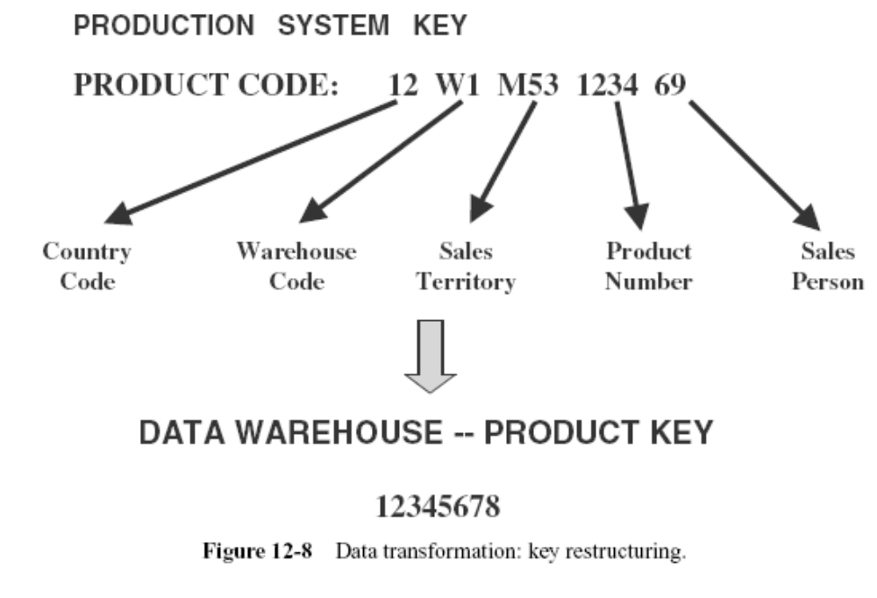

Slide 30
Data Integration and Consolidation
Entity Identification Problem
Multiple Sources Problem

Slide 31
Entity Identification Problem
If you have three different legacy applications developed in your organization at different times in the past, you are likely to have three different customer files supporting those systems.
Most of the customers will be common to all three files.
The same customer on each of the files may have a unique identification number.
These unique identification numbers for the same customer may not be the same across the three systems.
Solution - complex algorithms have to be designed to match records from all the three files and form groups of matching records. No matching algorithm can completely determine the groups. If the matching criteria are too tight, then some records will escape the groups. On the other hand, if the matching criteria are too loose, a particular group may include records of more than one customer.

Slide 32
Multiple Sources Problem
Single data element having more than one source.
A straightforward solution is to assign a higher priority to one of the two sources and pick up the product unit cost from that source. Sometimes, a straightforward solution such as this may not sit well with needs of the data warehouse users. You may have to select from either of the files based on the last update date. Or, in some other instances, your determination of the appropriate source depends on other related fields

Slide 33
DATA LOADING

Slide 34
DATA LOADING
Data loading takes the prepared data, applies it to the data warehouse, and stores it in the database
Terminology:
  Initial Load — populating all the data warehouse tables for the very first time
  Incremental Load — applying ongoing changes as necessary in a periodic manner
  Full Refresh — completely erasing the contents of one or more tables and reloading with fresh data (initial load is a refresh of all the tables)

Slide 35
Applying Data: Techniques and Processes
load,
append,
destructive
merge,
constructive merge.

Slide 36
Load
If the target table to be loaded already exists and data exists in the table, the load process wipes out the existing data and applies the data from the incoming file.
If the table is already empty before loading, the load process simply applies the data from the incoming file.

Slide 37
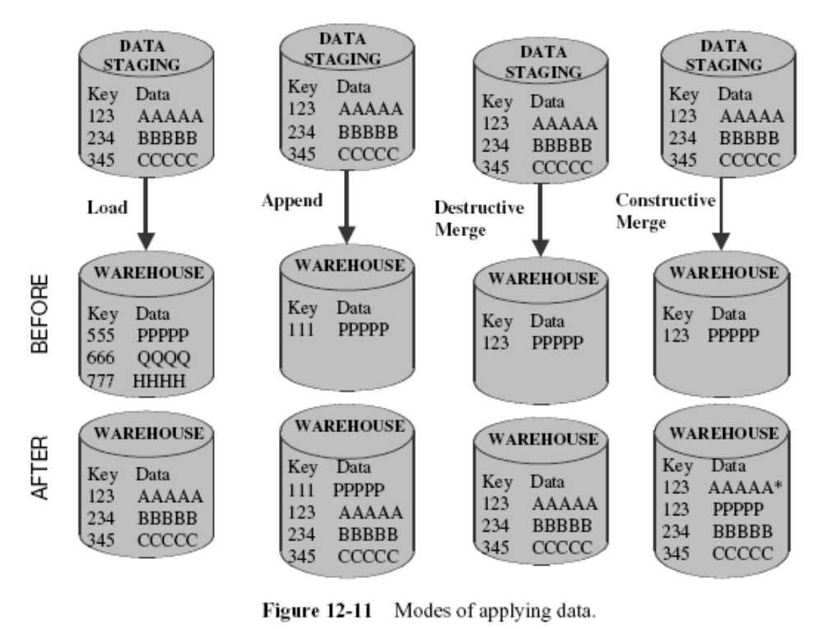

Slide 38
Append
extension of the load.
If data already exists in the table, the append process unconditionally adds the incoming data, preserving the existing data in the target table.
When an incoming record is a duplicate of an already existing record, you may define how to handle an incoming duplicate:
  The incoming record may be allowed to be added as a duplicate.
  In the other option, the incoming duplicate record may be rejected during the append process.

Slide 40
Destructive Merge
Applies incoming data to the target data.
If the primary key of an incoming record matches with the key of an existing record, update the matching target record.
If the incoming record is a new record without a match with any existing record, add the incoming record to the target table.

Slide 42
Constructive Merge
Slightly different from the destructive merge.
If the primary key of an incoming record matches with the key of an existing record, leave the existing record, add the incoming record, and mark the added record as superceding the old record.

Slide 44
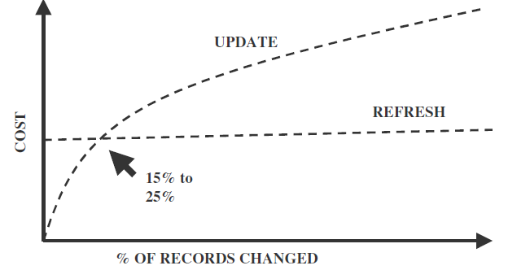
Data Loading
Data Refresh Vs. Data Update
Full refresh reloads whole data after deleting old data and data updates are used to update the changing attributes
Notes:
Now an important point. While data loading, since we may want to update records or we would like to do Type-I, Type-II, and Type-III changes. It is quite possible that in a typical data warehouse you might encounter a situation where it takes too much effort to do these changes. In fact, the cost of updating data might be quite costly than doing a full refresh of data warehouse. The full refresh means that old data will be deleted from data warehouse and new data will be loaded. In the above diagram it is shown that generally if the records that need to be updated is between 15% to 25% of total records then the effort of updating record and doing a full refresh will be nearly same. It is therefore recommended that we should seriously consider full refresh when the cost of updating records surpass the effort of doing data updates.
Please move to the next slide

Slide 45
ETL Tools Options
Data transformation engines
Data capture through replication
Code generators

Slide 46
Data transformation engines
Consist of dynamic and sophisticated data manipulation algorithms.
The tool suite captures data from a designated set of source systems at user-defined intervals, performs elaborate data transformations, sends the results to a target environment, and applies the data to target files.
These tools provide maximum flexibility for pointing to various source systems, to select the appropriate data transformation methods, and to apply full loads and incremental loads.
The functionality of these tools sweeps the full range of the ETL process.

Slide 47
Data capture through replication
Most of these tools use the transaction recovery logs maintained by the DBMS.
The changes to the source systems captured in the transaction logs are replicated in near real time to the data staging area for further processing.
Some of the tools provide the ability to replicate data through the use of database triggers. These specialized stored procedures in the database signal the replication agent to capture and transport the changes.

Slide 48
Code generators
Tools that directly deal with the extraction, transformation, and loading of data.
The tools enable the process by generating program code to perform these functions.
The tools generate most of the program code in some of the common programming languages.
Own program code can be added, also.

Slide 49
